Slide 1
Managing Project and Teams
Lecture 9: Leading The Project Team

Slide 2
Key topics covered in this lecture

Slide 3
What we will cover in this lecture
By the end of the lesson, students should be able to:
Understand the need for power
Identify sources of power
Understanding performance management

Slide 4
Summary

Slide 5
Making Team Decisions
During the course of a project, many decisions are made each day that ultimately affect the project for good or ill.
Some are small decisions with relatively little impact, whereas others have major impact.
Some are small decisions with relatively little impact, whereas others have major impact.

Slide 6
Advantages of group discussions
It provides a broader perspective.
It contributes more experience and ideas.
It gets the commitment of others in the decision.
Diverse perspectives
Risk mitigation
Strengthened Relationships
Increased engagement and Motivation

Slide 7
Disadvantages of group discussions
Be willing to negotiate
The meeting may be more difﬁcult to control— it may get bogged down because of the size of the group.
The decision may alienate some people- You can not please everyone
Not everyone has helpful insights or expertise.

Slide 8
Group/Team Decisions
So when should you involve others.
When should you not involve others

Slide 9
Types of Power
Influence –Involves sharing power and getting others to cooperate for common goals.
Negotiation- Negotiation is often used between people of differing levels of authority.
Coercion- Coercion is imposing power through formal organizational lines.

Slide 10
Importance in understanding power sources
Influence and Decision Making- Power sources determine who has the authority to make decisions and influence project outcomes.
Team Dynamics: This allows project managers to manage conflicts, motivate team members, and allocate resources more effectively.
Stakeholder Management - Understanding their sources of power enables project managers to engage with stakeholders more strategically, build alliances, and address their concerns proactively.
Risk Management - Power imbalances among stakeholders can create risks for the project, such as resistance to change or conflicting priorities.
Project success

Slide 11
Sources of Power
Expert power- is the ability to gain support because people perceive that the project manager has special knowledge or expertise they consider important.
Relationship power - is the ability to gain support because others feel they have a caring work relationship with the project manager.
Referent power- is the ability to gain support because of the desire of others to identify with the project manager or the project.
Authority power -is the ability to gain support because others perceive the project manager has the power to issue orders.
Reward/Penalty power is the ability to gain support because people perceive that the project manager is capable of directly or indirectly dispensing rewards or penalties.
Connection Power
Information Power

Slide 12
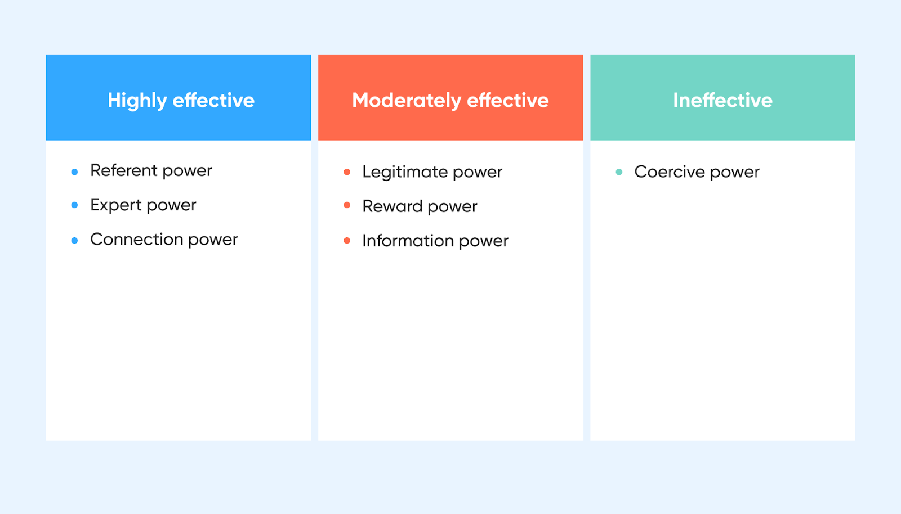
Effectiveness of the different forms of power
Notes:
Effective leaders know how to draw on the different types of power in different situations.
Use coercion only in times of employee misconduct

Slide 13
Role of Power Dynamics in Leadership Styles
Different leadership styles reflect different power dynamics and understanding these dynamics can help a leader adapt their style to the needs of their team and project.
Transformational Leadership- leverage referent and expert power to motivate and inspire their teams. Leads by example.
Transactional Leadership- rely on reward and coercive power.
Servant Leadership- leverage referent power, placing the needs of their team members above their own. Prioritise transparency.
Autocratic Leadership- Autocratic leaders primarily use positional and coercive power.

Slide 14
Managing Change
People resist change because it upsets their familiar environment and makes them feel insecure.
Some organisations openly adopt a change freeze , or no-change mentality, after a particular phase in the project life cycle, typically after Definition.
So how best can you implement change?
Identify need for change
Create a transition plan- Show the team members benefits from the change
Implement the plan- Carefully articulate the reasons for the change and its potential impact on the people involved.
The result of any of the above will trigger a change request .

Slide 15
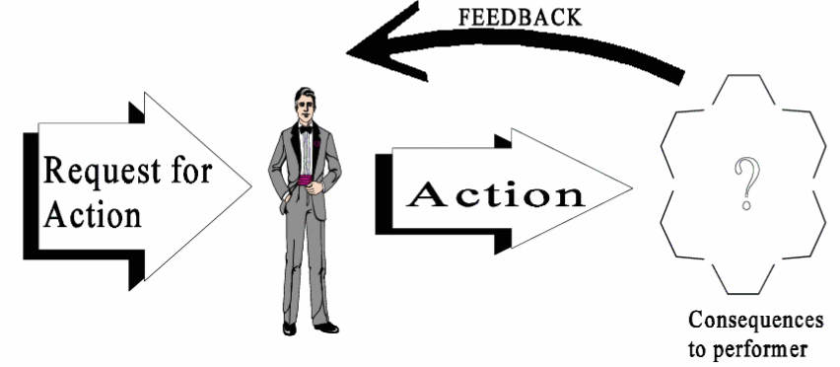
Performance management
A primary job of the project manager is to manage project performance.
The on-going process of minimizing the number and impact of problems and providing an environment wherein the project can succeed..

Slide 16
Project Management Tools
Asana
Kanban
Freedcamp
OpenProject
Project Libre
Microsoft Project
Odoo

Slide 17

Key takeaway points
ⓘ Start presenting to display the poll results on this slide.

Slide 18
Next Lesson
Stakeholder Analysis and Management

Slide 19
References
RGuide, P.M.B.O.K., (2017). A Guide to the Project Management Body of Knowledge (PMBOK® Guide), Project Management Institute.
Marion, James W.. Project Management : A Common Sense Guide to the PMBOK, Part One-Framework and Schedule, Momentum Press, 2018. ProQuest Ebook Central, http://ebookcentral.proquest.com/lib/ucsl/detail.action?docID=5264990.
Richman, Larry. (2002). Project Management Step-by-Step, AMACOM, ProQuest Ebook Central, http://ebookcentral.proquest.com/lib/ucsl/detail.action?docID=243071.
Starting Out in Project Management, Association for Project Management, 2018. ProQuest Ebook Central,
Verzuh, E. (2015). The fast forward MBA in project management. John Wiley & Sons.
Ward, G.G. (2018). Effective project management: guidance and checklists for engineering and construction. John Wiley & Sons.

